Slide 1
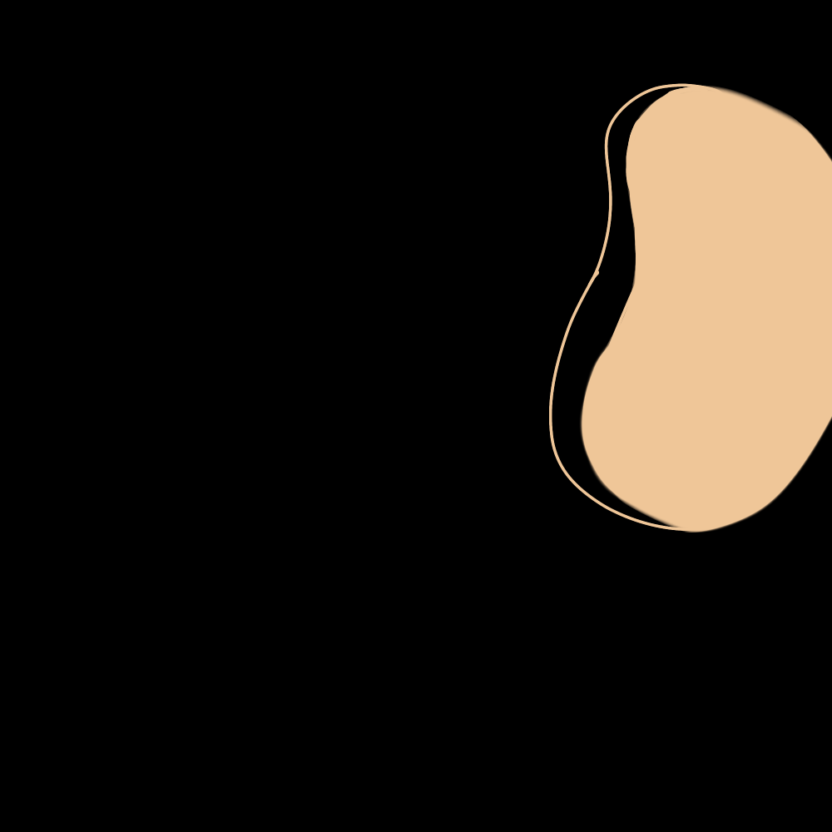
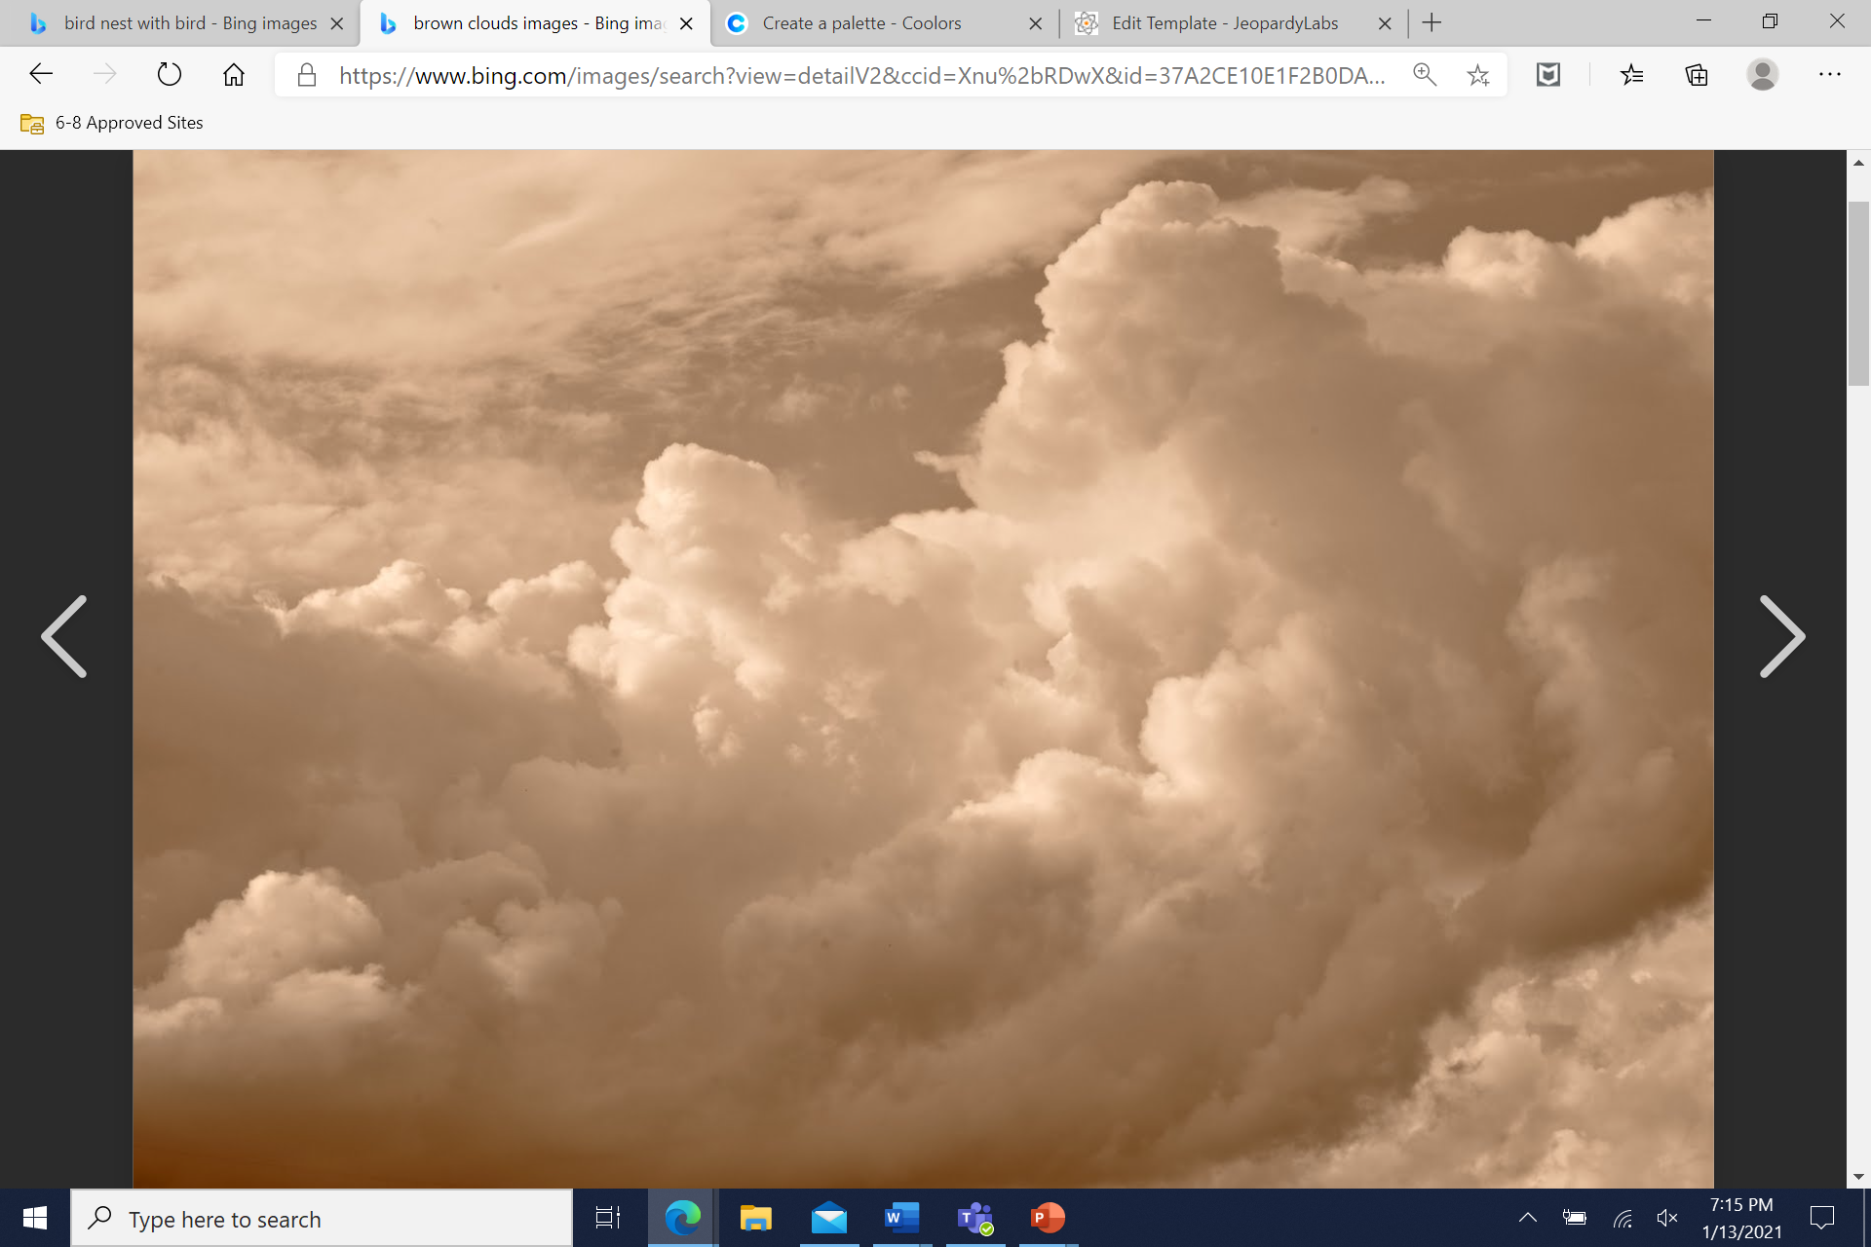
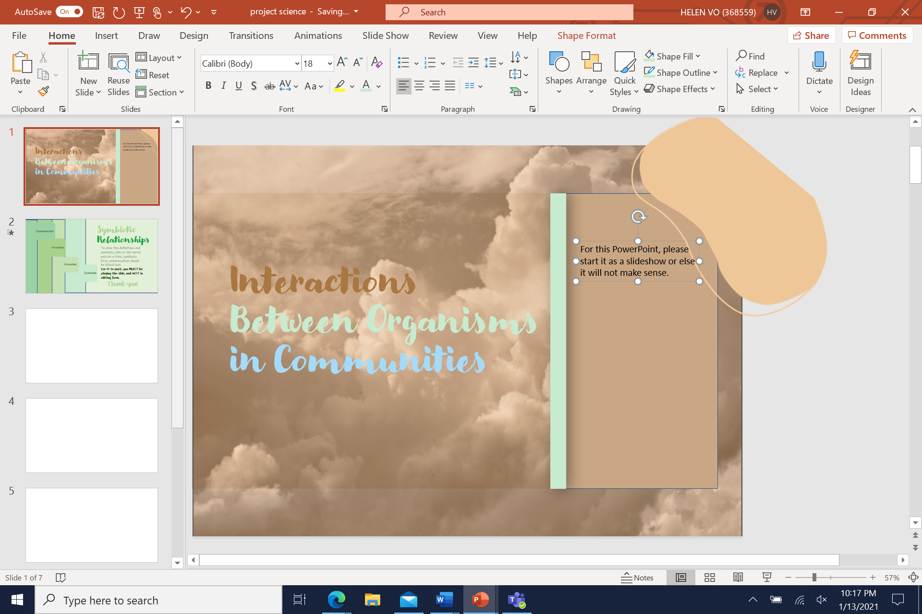
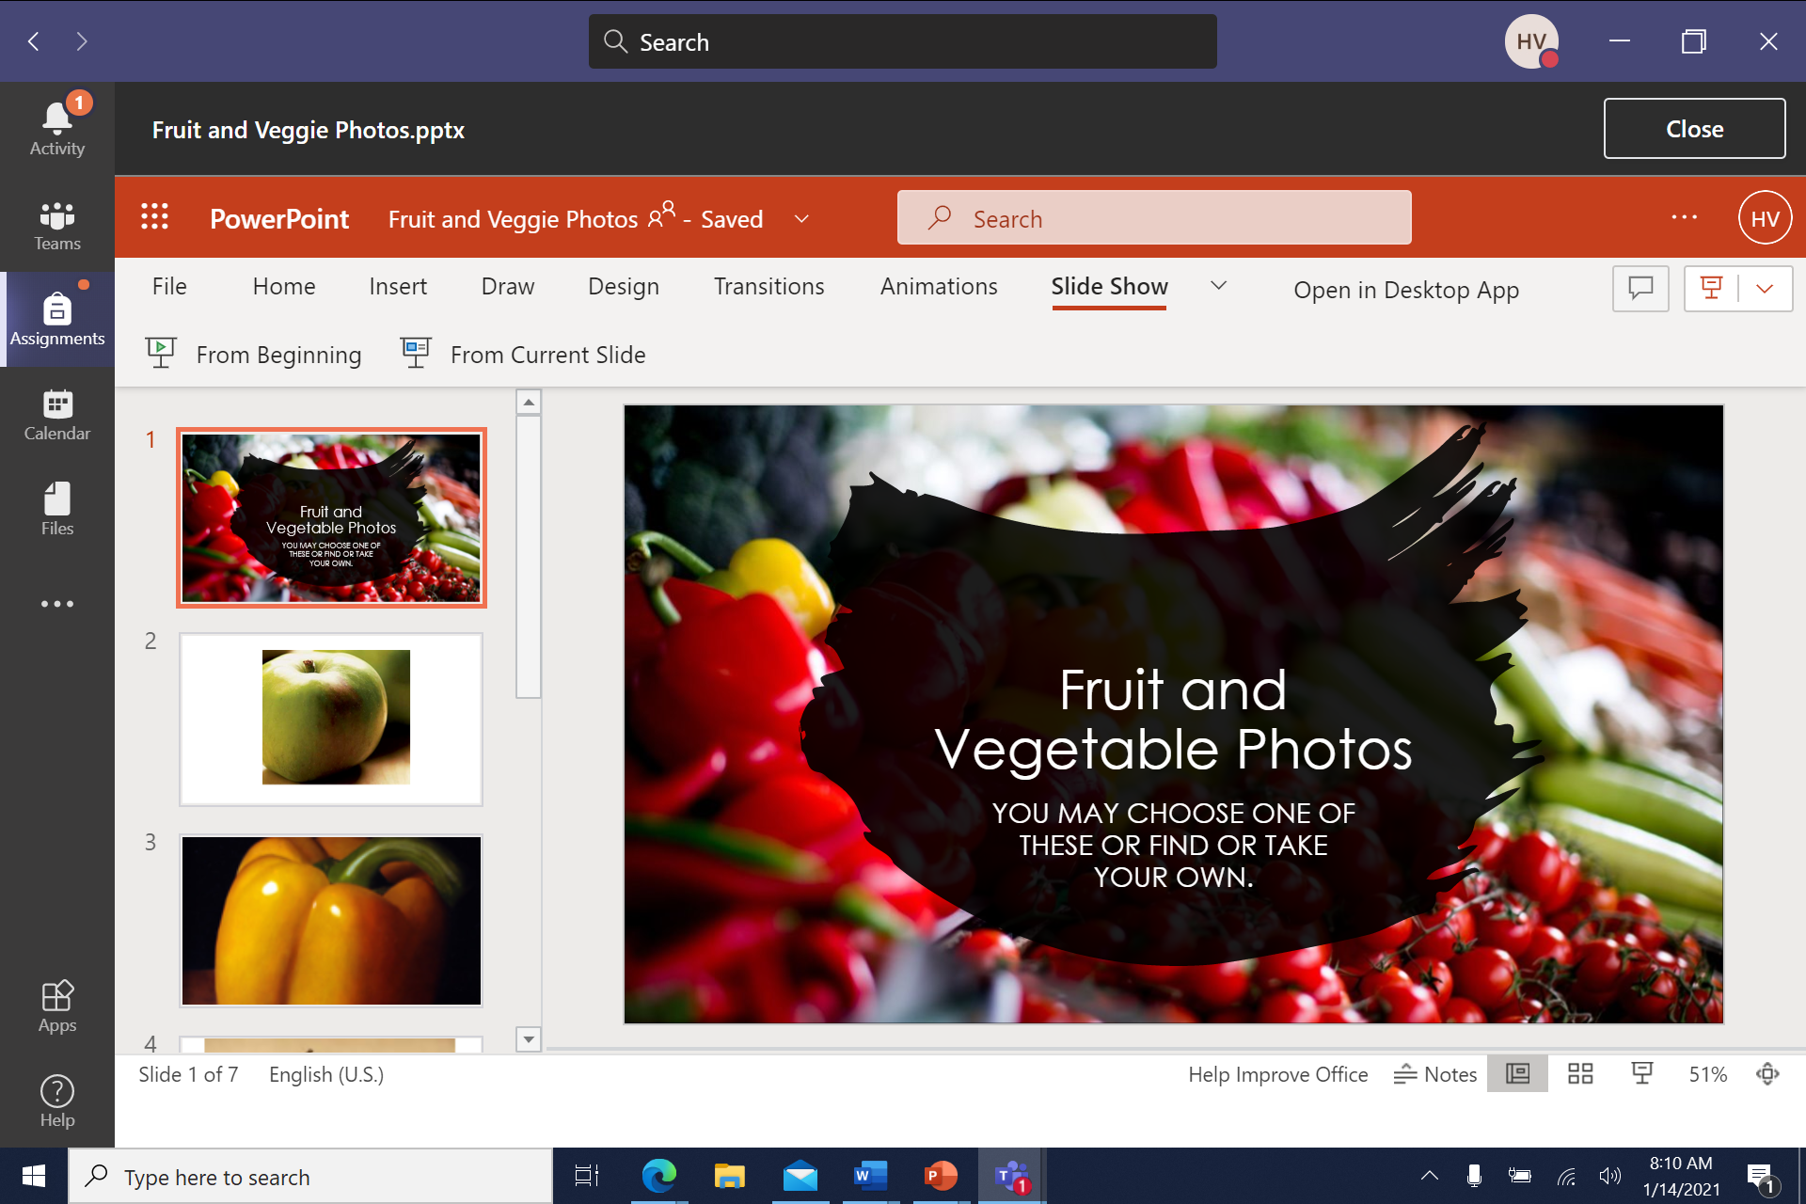
Important Information
For this PowerPoint, please start it as a presentation or else it will not make sense.
This button can be found on the top left of the screen when PowerPoint is opened. (red one )
It can also be on the right if you’re just viewing it from Teams. (White one on the right)
(red one) (white one)
On the left on the right
Interactions Between Organisms in Communities

Slide 2
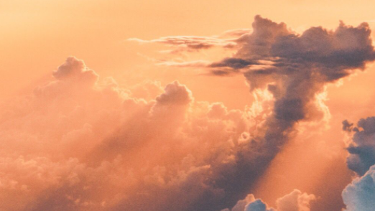

In this project, we will be going over…
Symbiotic Relationships
Invasive and Native Relationships
Competitive and Cooperative Relationships
Predator and Prey Relationships

Slide 3
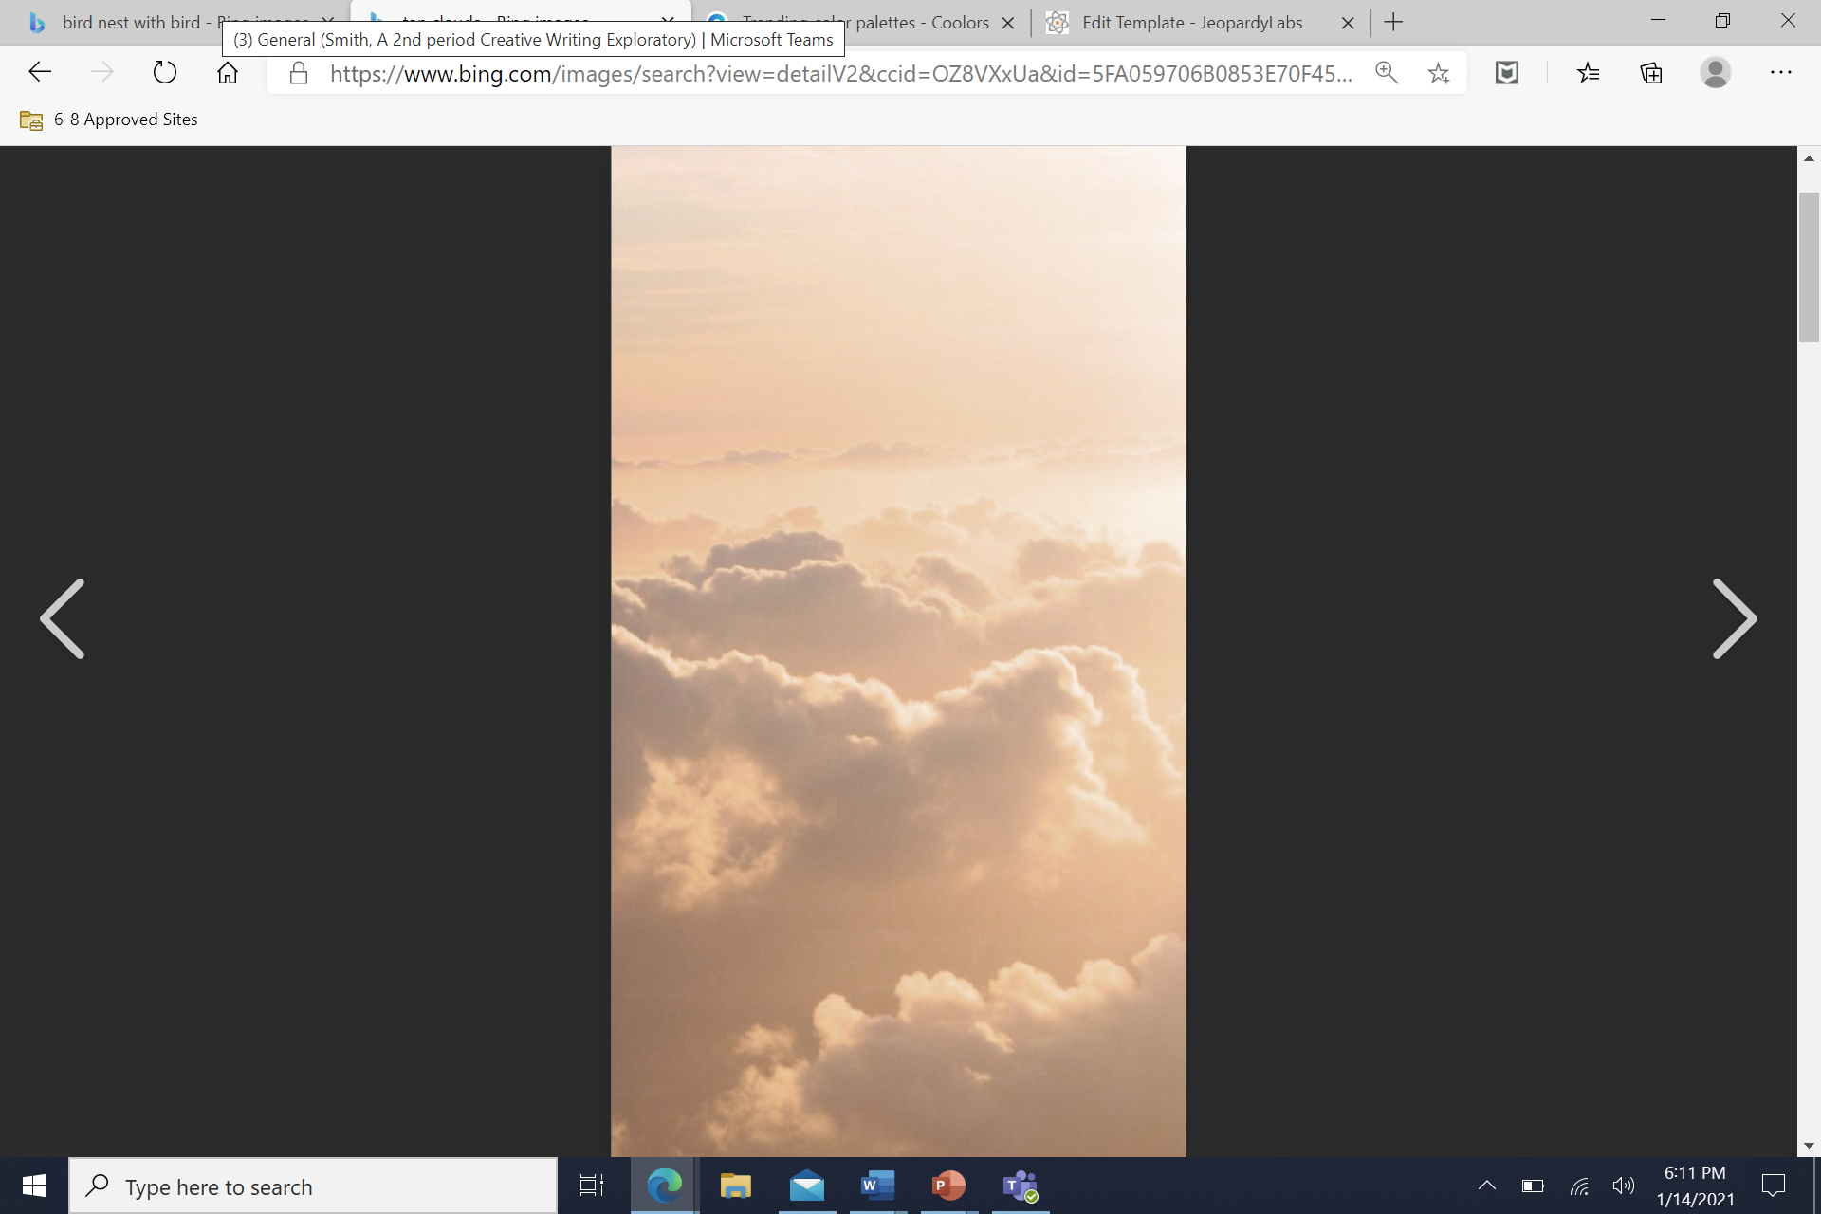
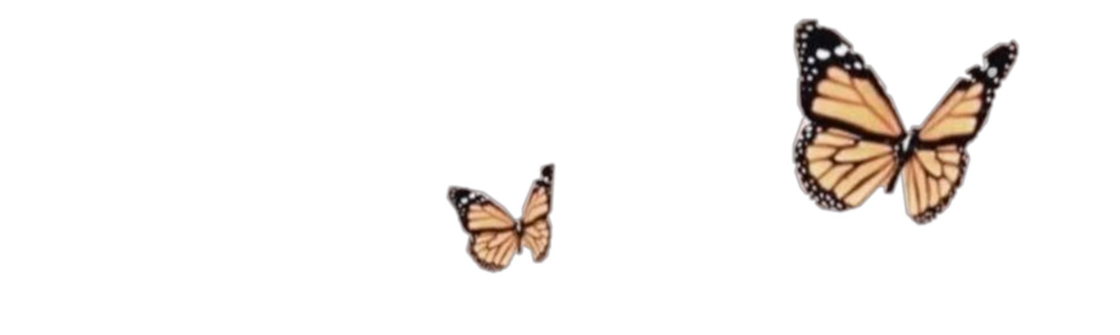
Objective
Students will be able to construct explanations to show patterns in interdepent relationships in ecosystem IOT explain the cause and effect relationship between organisms.

Slide 4
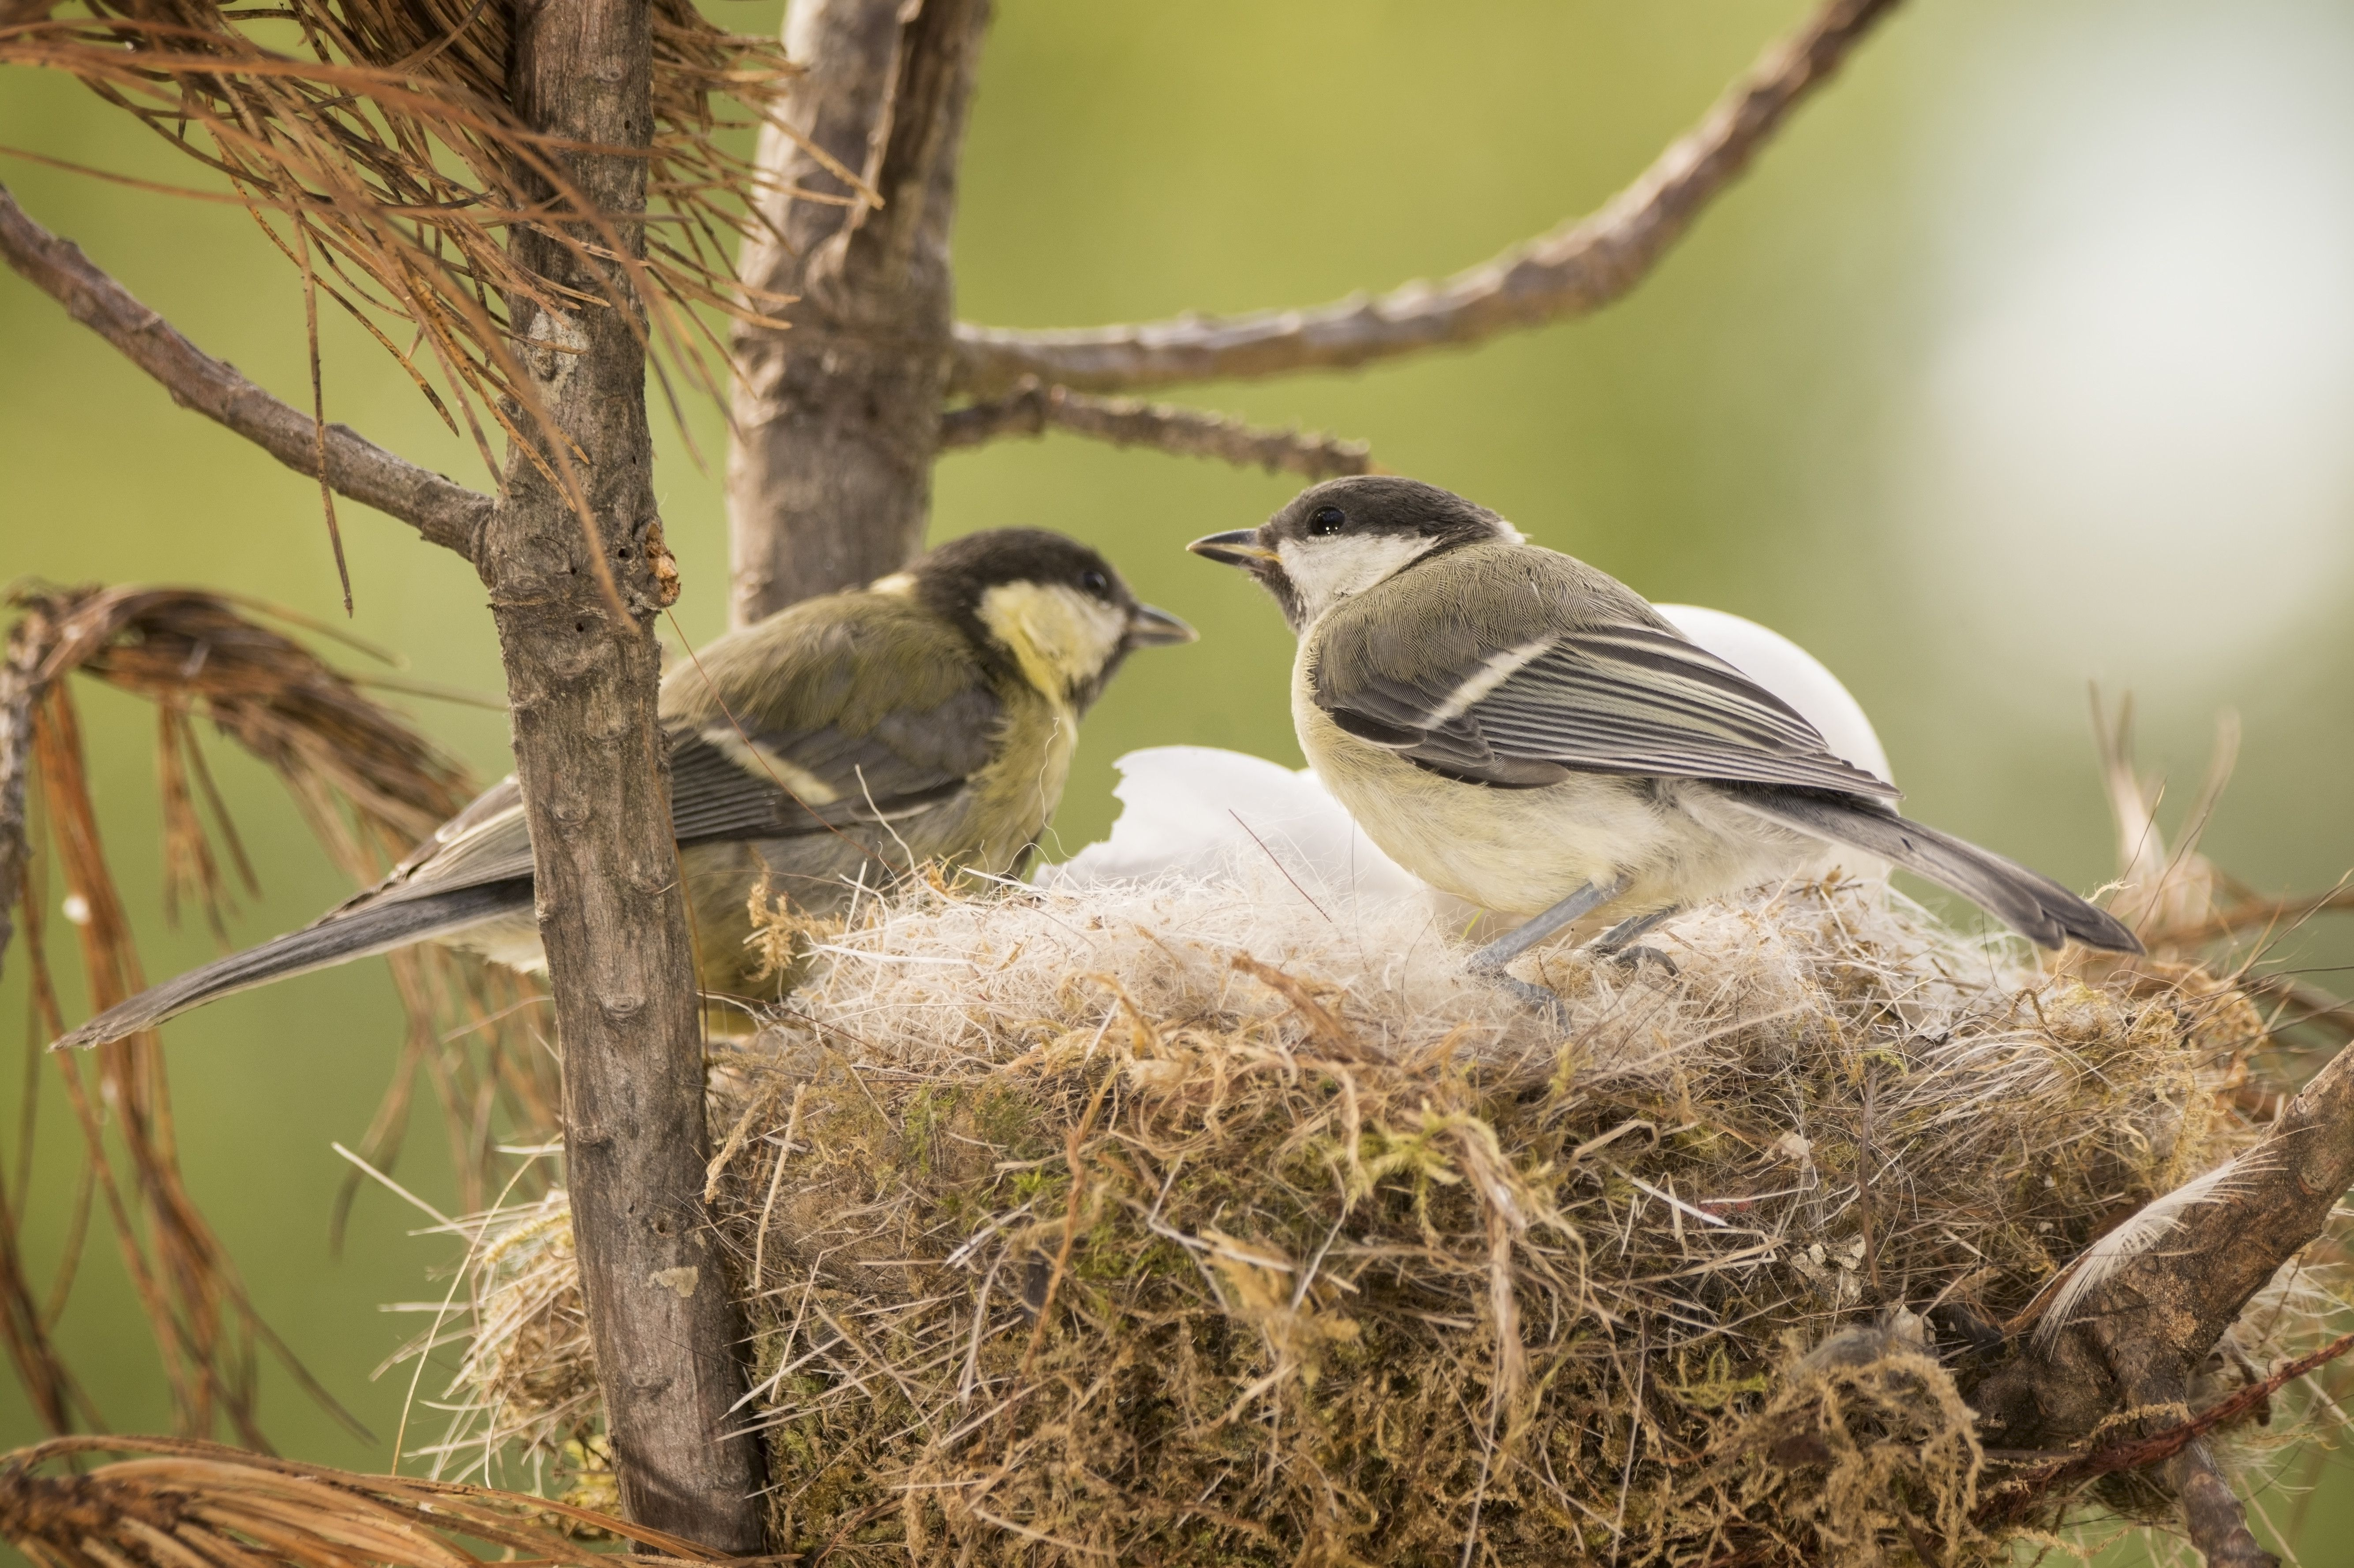
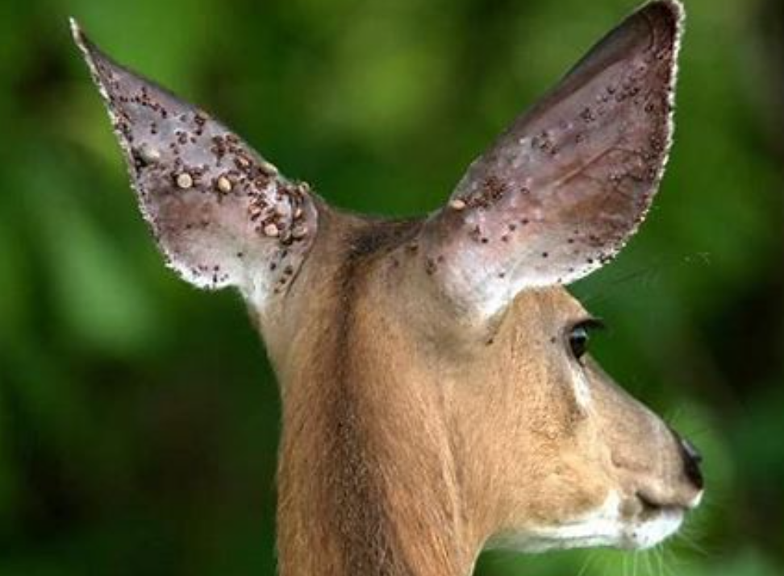
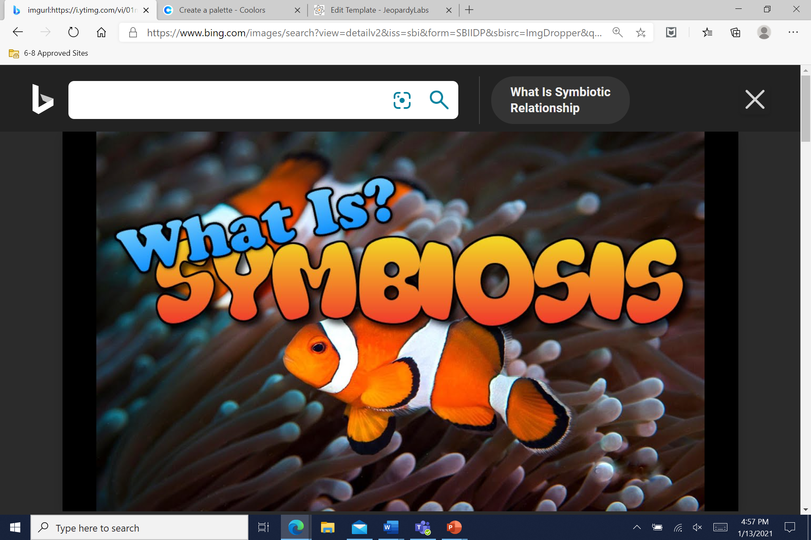
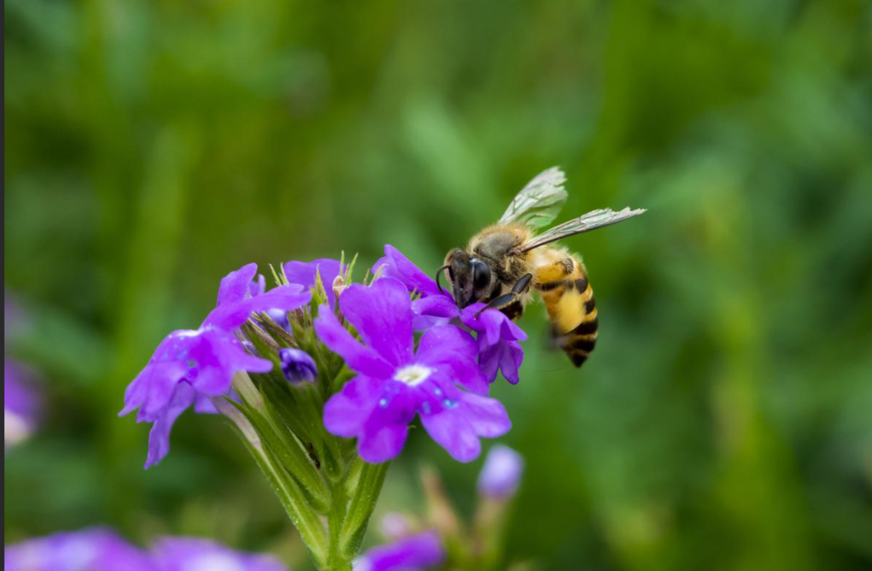
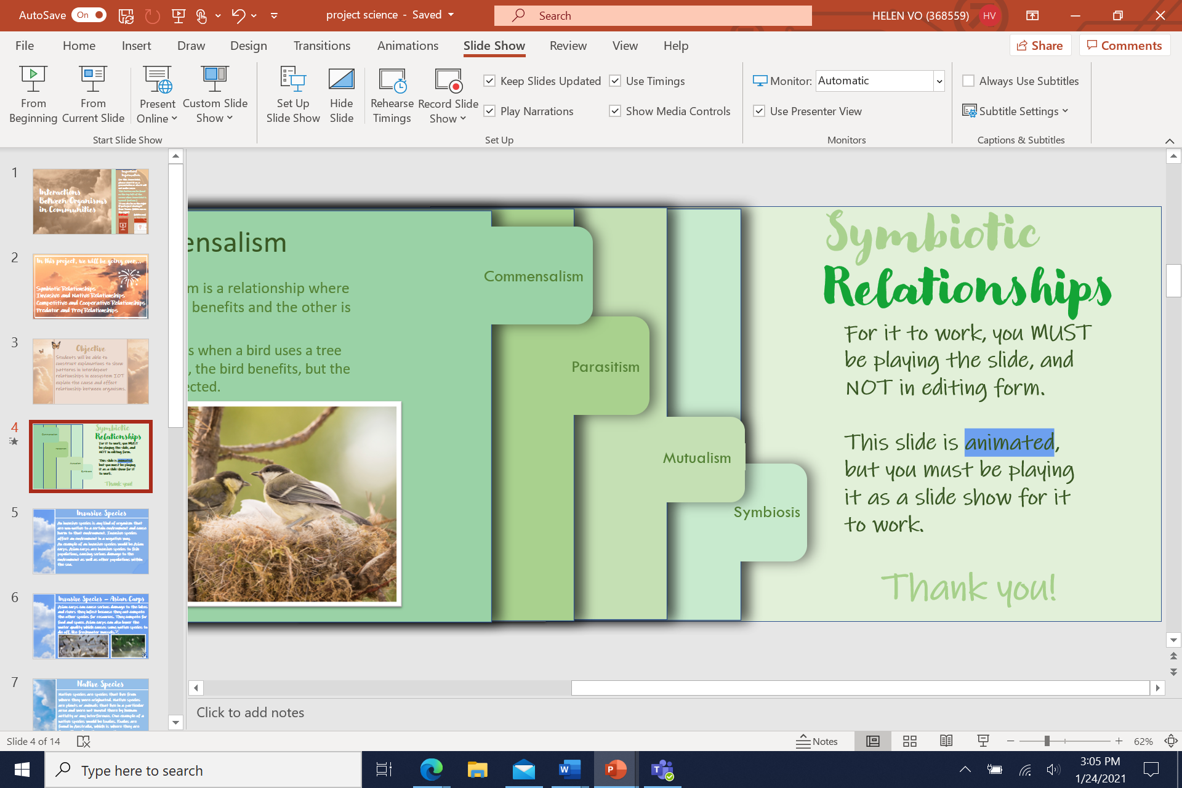
B
Symbiotic Relationships
Mutualism
Commensalism
Symbiosis
Parasitism
Mutualism is a relationship in which both organisms in the relationship benefit.
Commensalism
Parasitism is a relationship where one organism benefits and the other is harmed.
Commensalism is a relationship where one organism benefits and the other is not affected.
Symbiosis is a close long-term relationship between different species in a community.
One example is deer ticks. Deer ticks are found on deer but can also spread to other animals. They take the blood of deer and weaken the deer.
For it to work, you MUST be playing the slide, and NOT in editing form.
This slide is animated, but you must be playing it as a slide show for it to work.
Thank you!
One example is when a bird uses a tree to build a nest, the bird benefits, but the tree is not affected.
One example of mutualism is when a bee gets pollen from a flower. The bee gets pollen, goes to another flower, and leaves some on the next flower causing the flower to grow.
Parasitism
Mutualism
Click “From Beginning” or “From Current Slide.”
Symbiosis

Slide 5
Cause and Effect – Symbiotic Relationships
Cause
Effect
The bee gets pollen from a flower and goes to another flower.
Mutualism
The pollen from the bee gets onto the other flower which causes the flower to grow.
Parasitism
There are multiple deer ticks on the deer’s ears.
The deer gets blood taken away, slowly, which weakens the deer as well as the fawn it may produce.
Commensalism
The bird builds a nest on the free space of the tree.
The bird benefits from getting a home and the tree is not affected and will grow normally.

Slide 6
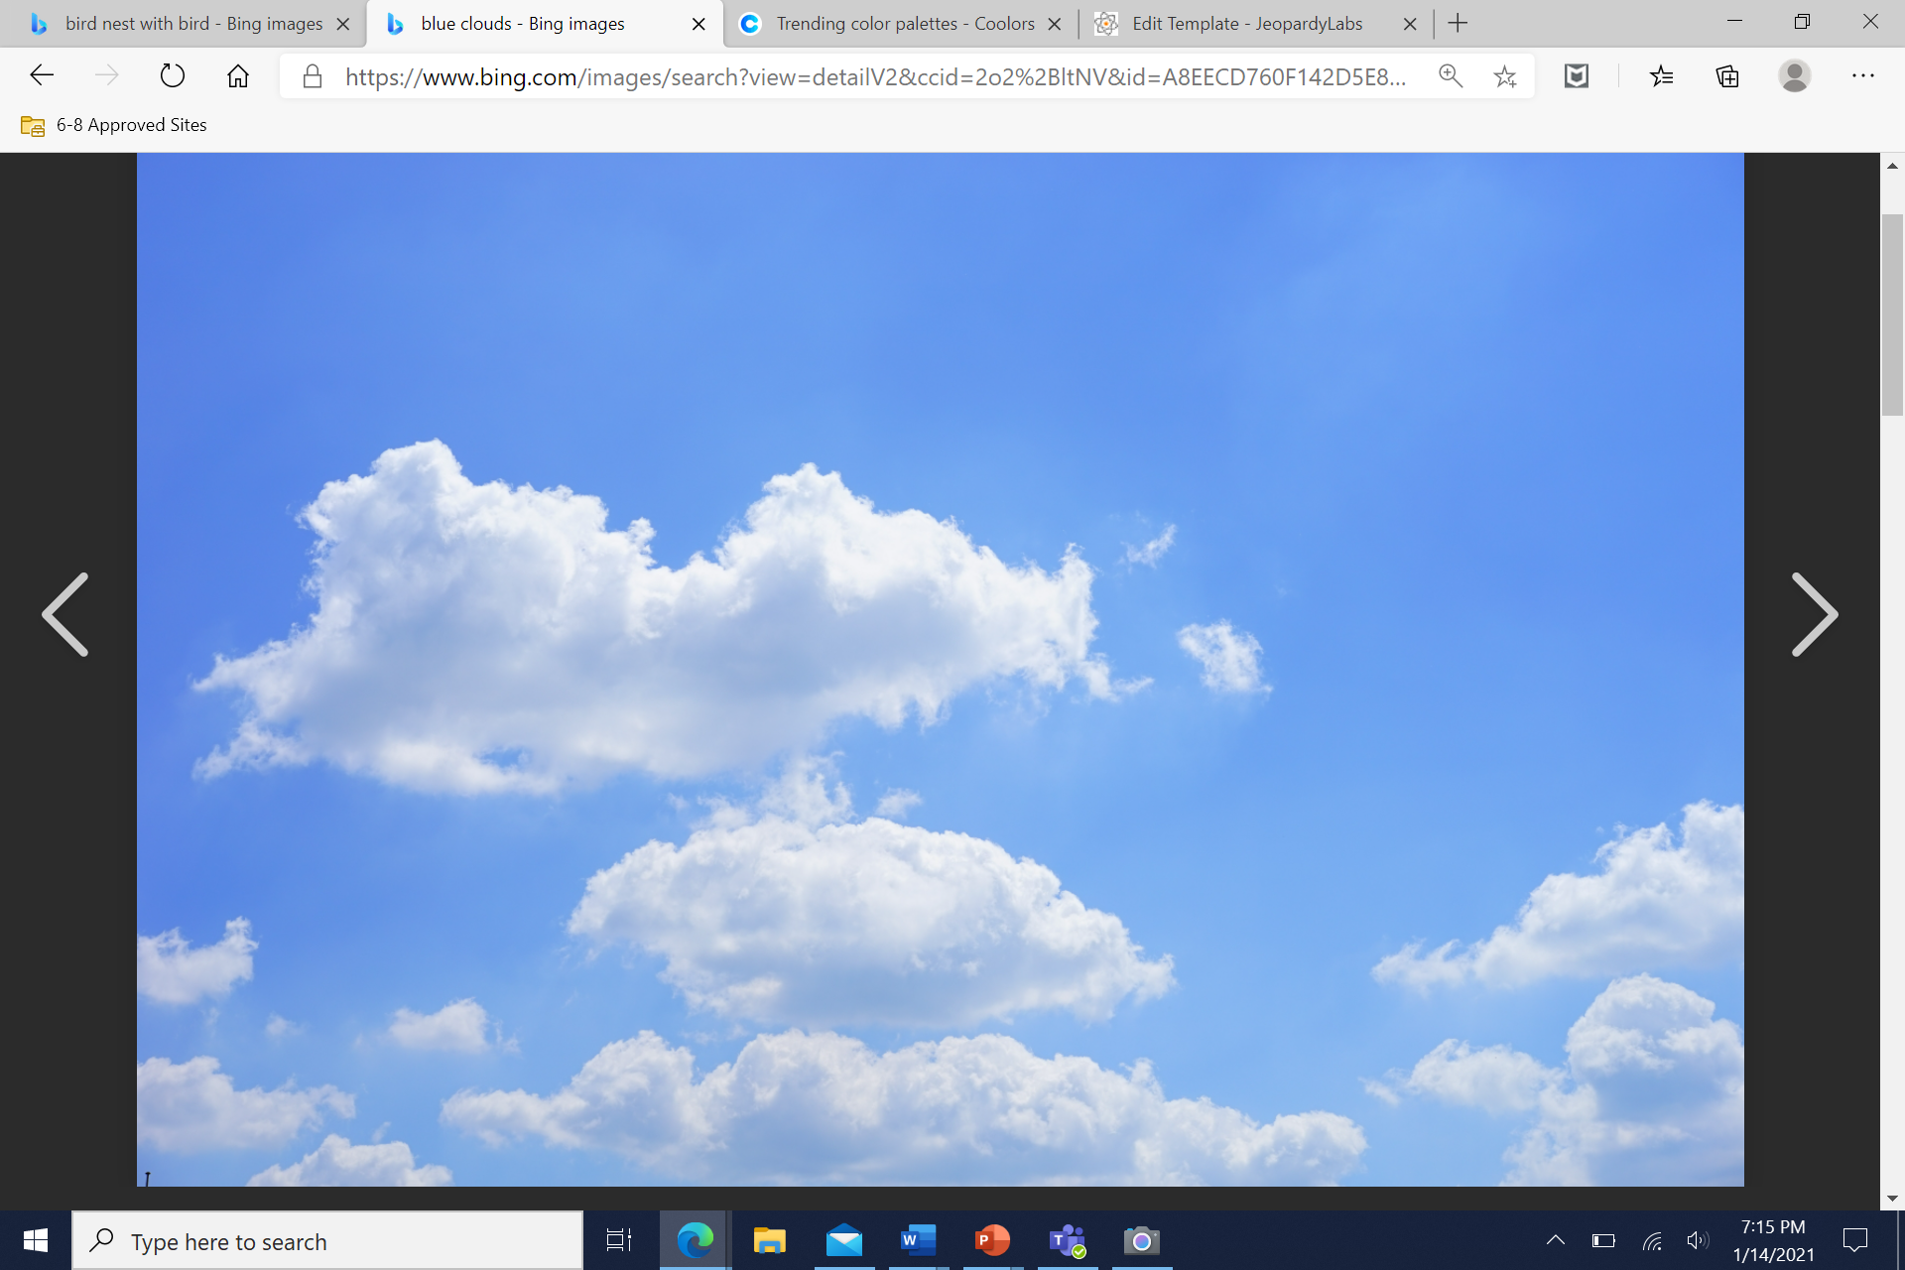
Invasive Species
An invasive species is any kind of organism that are non-native to a certain environment and cause harm to that environment. Invasive species affect an environment in a negative way.
An example of an invasive species would be Asian carps. Asian carps are invasive species to fish populations, causing serious damage to the environment as well as other populations within the sea.

Slide 7

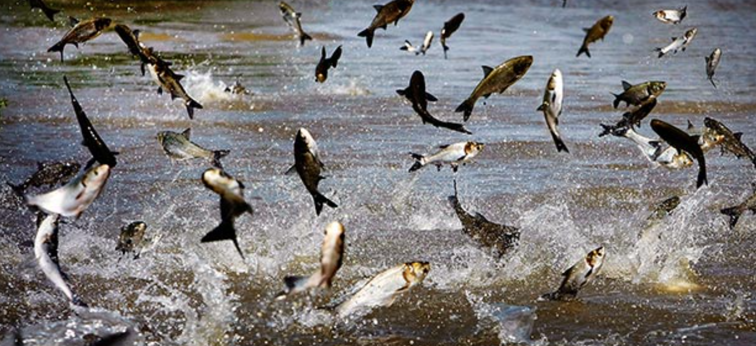
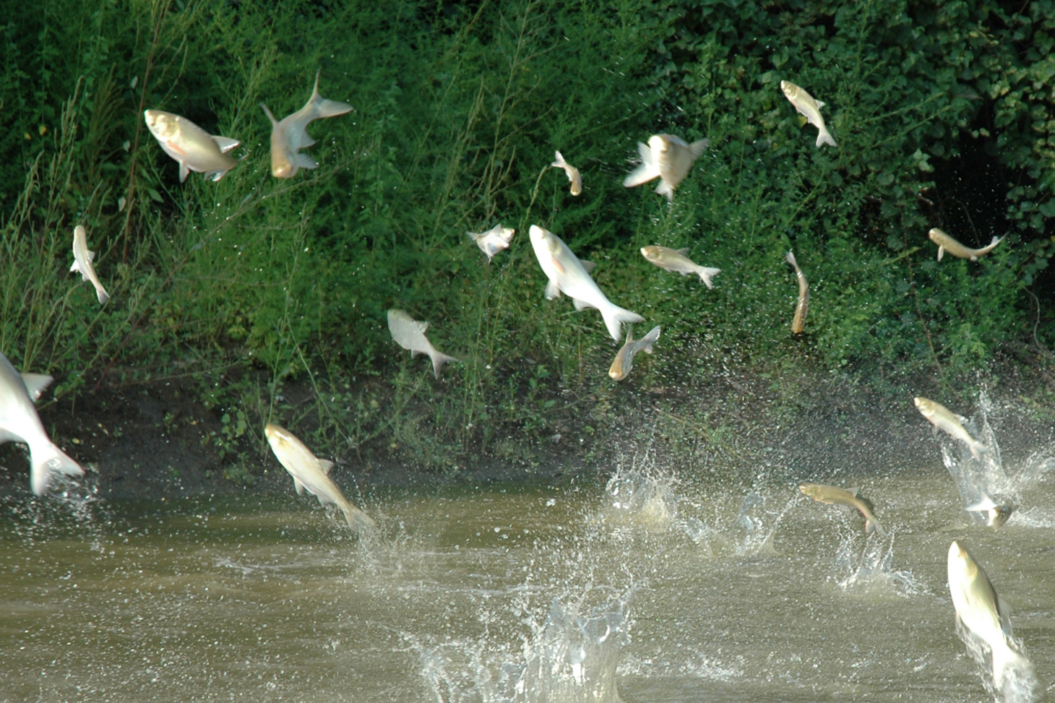

Invasive Species – Asian Carps
Asian carps can cause serious damage to the lakes and rivers they infest because they out-compete the other species for resources. They compete for food and space. Asian carps can also lower the water quality which causes some native species to die off, like freshwater mussels.

Slide 8
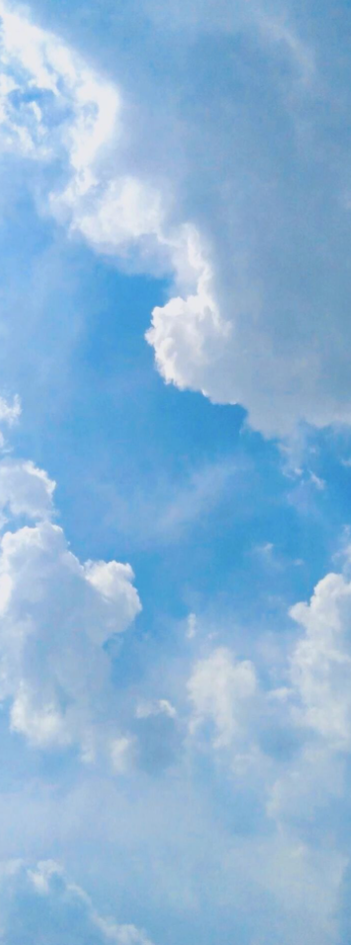
Native Species
Native species are species that live from where they were originated. Native species are plants or animals that live in a particular area and were not moved there by human activity or any interference. One example of a native species would be freshwater mussels. Freshwater mussels are found in Australia, which is where they are from. Therefore, they are native.

Slide 9
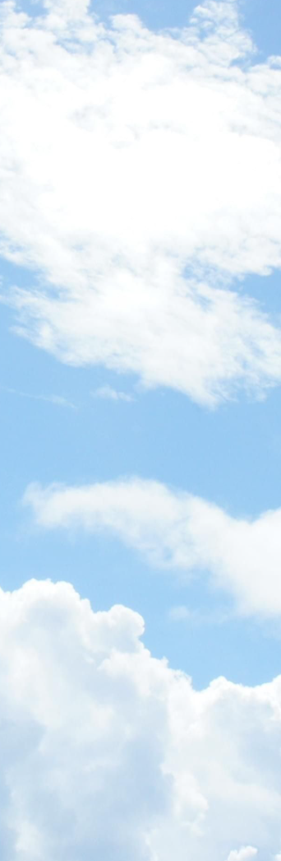
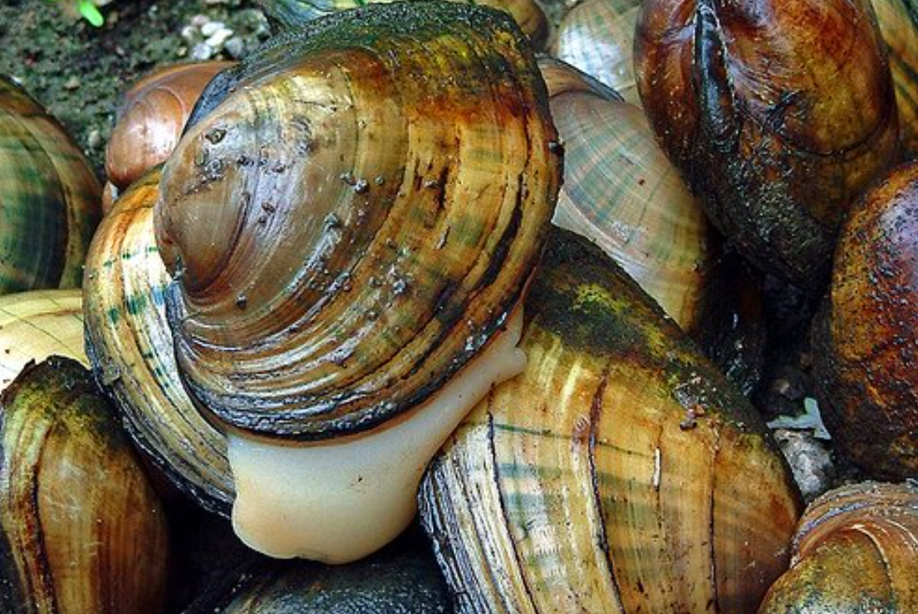
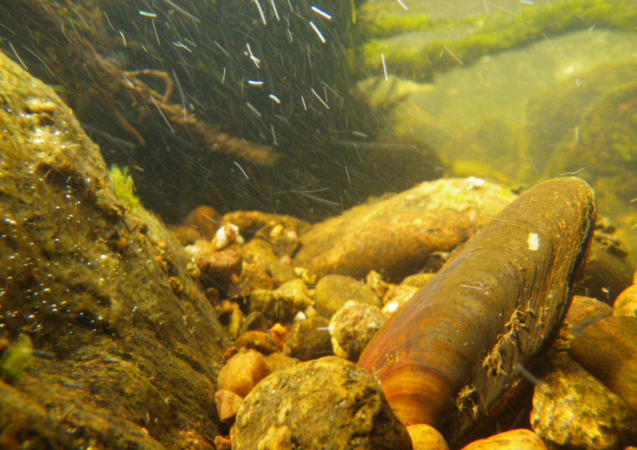
Native Species – Freshwater Mussels
Freshwater mussels are native species because they are originally from Australia, and they were not moved there by any human activity, intervention, or interference.

Slide 10
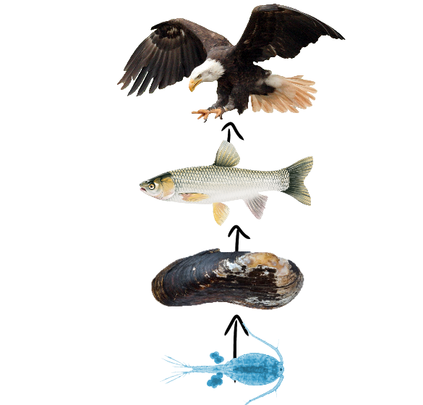
Food Chain
Bald eagle - Tertiary consumer
Asian carp - Secondary consumer
Freshwater mussel - Primary consumer
Zooplankton - Producer

Slide 11
Cause and Effect – Freshwater Mussels and Asian Carps
Asian carps invade different lakes and rivers.
The native fish populations are seriously damaged, as well as the water quality lowering.
c
Low water quality and damaged populations.
The different populations and communities start to die because of little food and water quality.
Some populations may migrate as well as die from the infested waters, causing even less food which may eventually lead to it being abandoned.
c
The lake or river has little food and space.

Slide 12
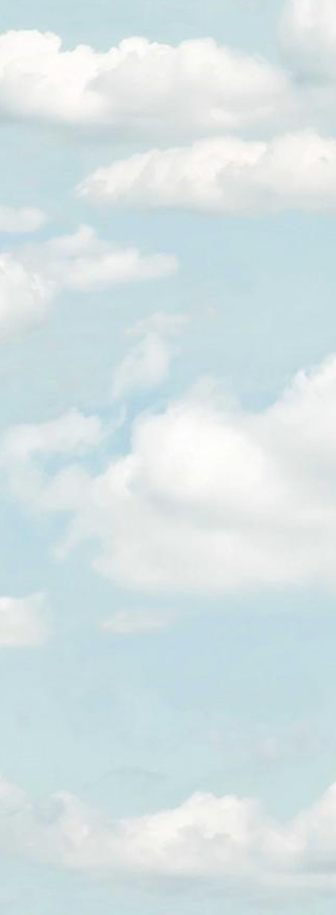


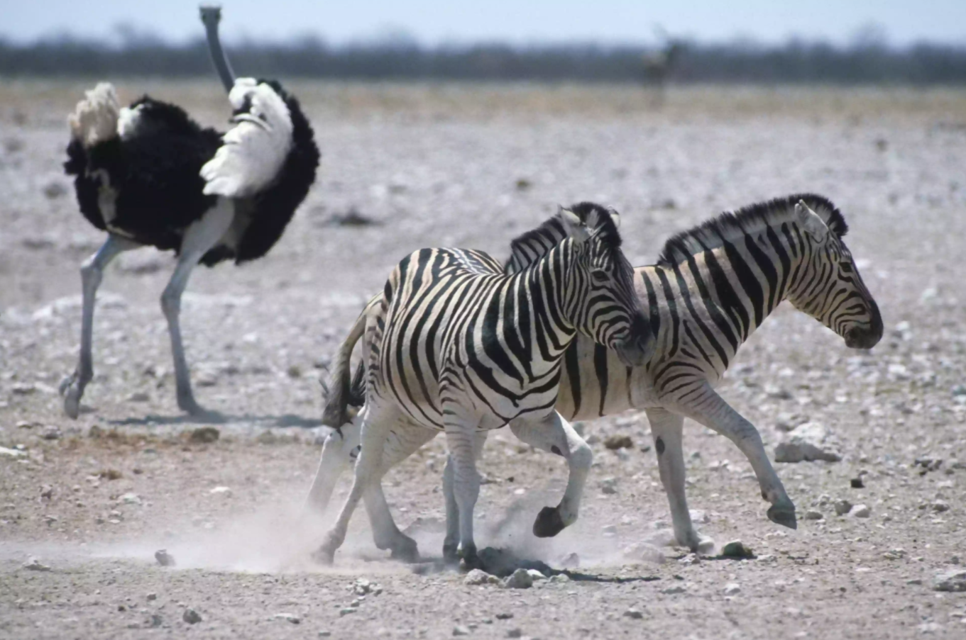
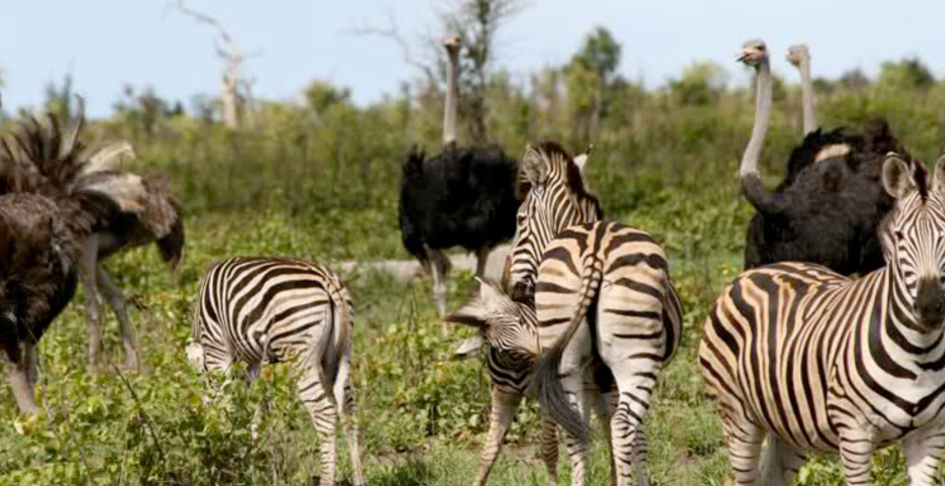
Cooperation
Cooperation is when individuals or organisms work together. An example of cooperation would be ostriches and zebras. Ostriches have a good sense of smell, but bad eyesight. Vice versa for zebras. They are both smart animals and prey, so they hang out with each other to avoid predators.

Slide 13
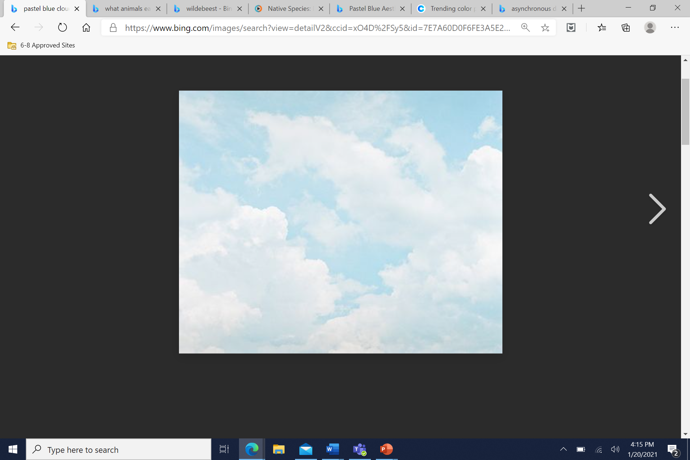
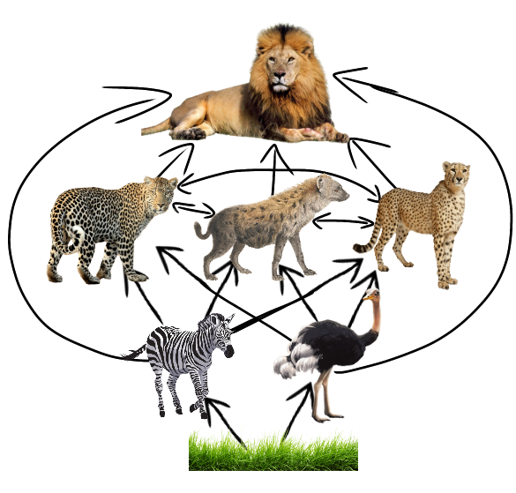
Food Web for Zebras and Ostriches
lion
cheetah
spotted hyena
leopard
ostrich
zebra
vegetation

Slide 14
Cause and Effect – Zebras and Ostriches
Cause Effect
Zebras and ostriches working together, warning each other if a predator is nearby.
The predators will get less prey, which may cause some of the predators to die.
Zebras and ostriches working together, warning each other if a predator is nearby.
The zebra and ostrich population will increase if they continue to work together.
Zebras and ostriches working together, warning each other if a predator is nearby.
It is possible that if the animals do not get away in time, more of the population will die out because there will be more prey in one group for the predator to consume.

Slide 15
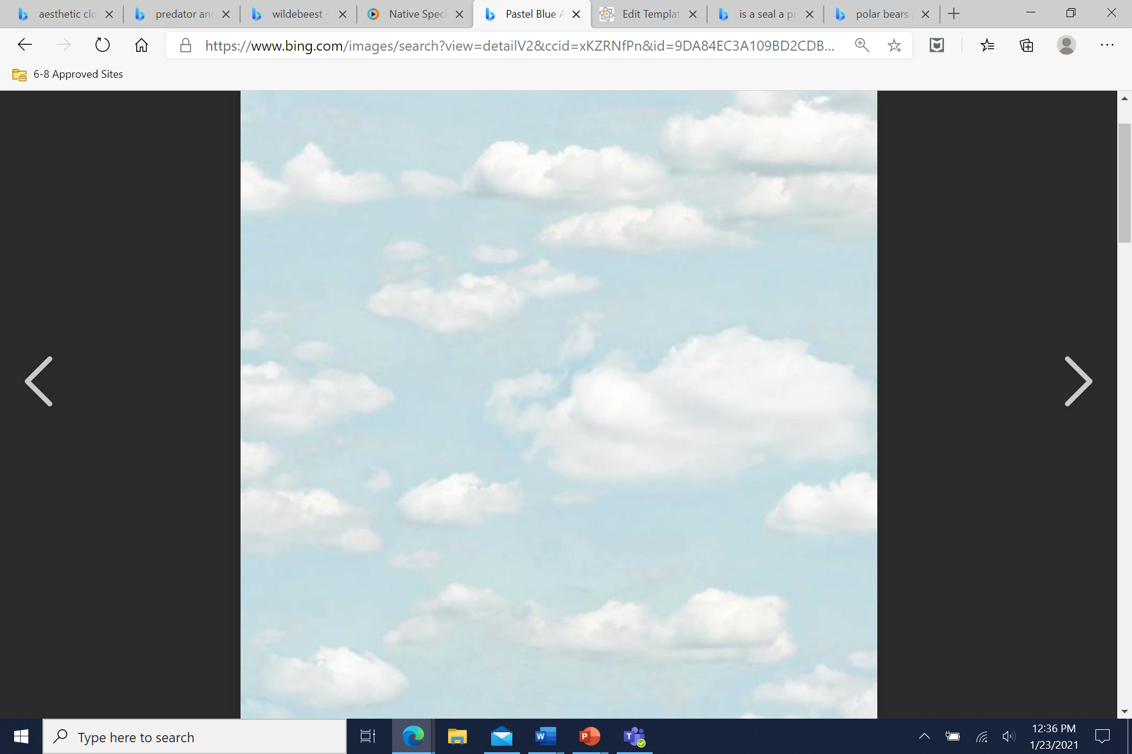
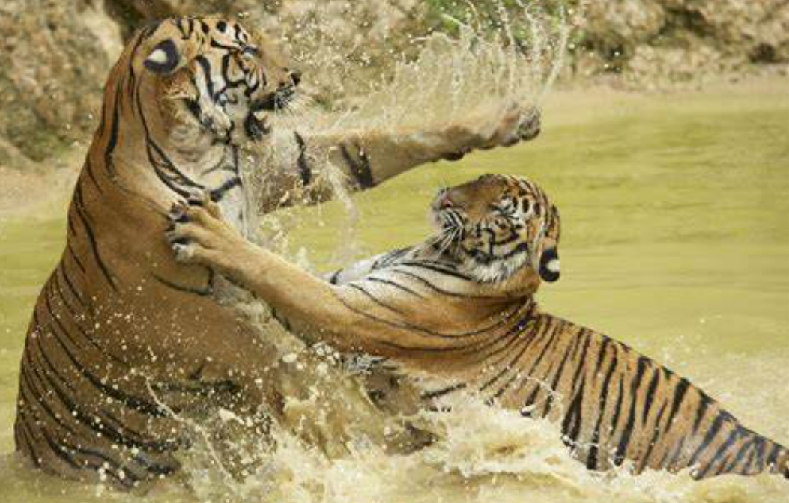
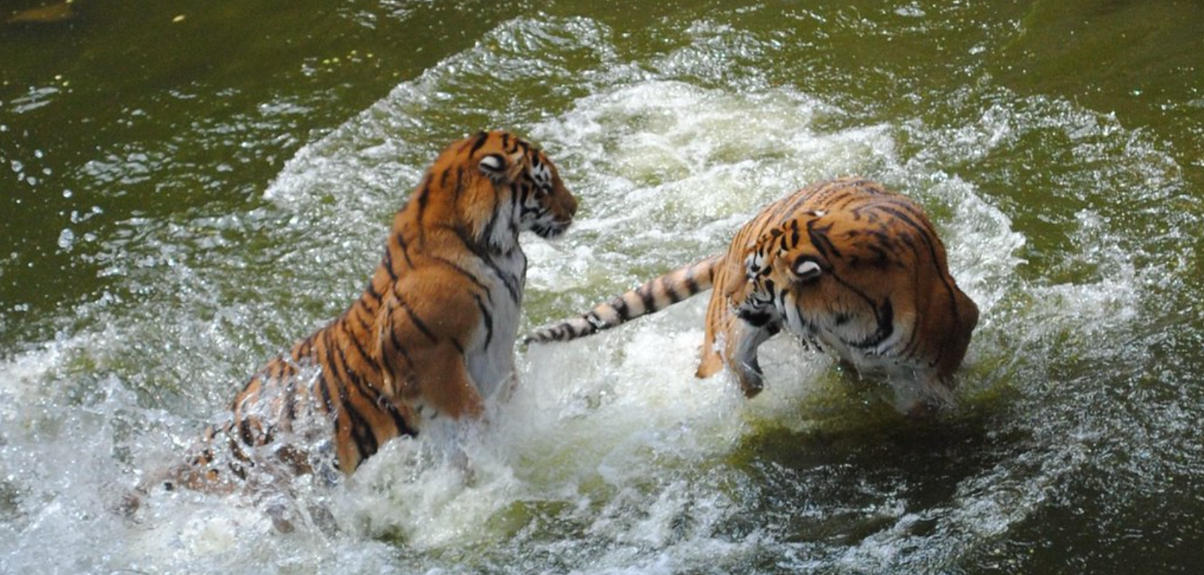

Competitive
Competition is when two or more organisms or populations try and fight over the same limited resource, whether it be food, water, shelter, etcetera. Competition can happen by anyone, even ones of the same species.
An example of competition would be two tigers fighting over water. This is just one example, but there is lots of competition within organisms.

Slide 16
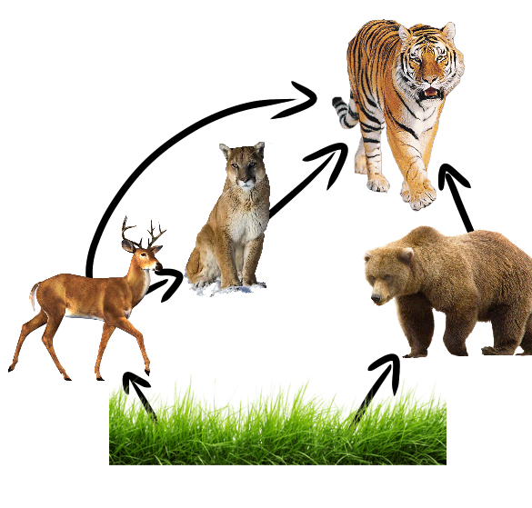
Competition – Tiger Food Web
(This food web is just a simple version of an actual tiger food web! Tigers are at the top of the food web and eat tons of different animals.)
Tiger
Cougar
Bear
Deer
Grass

Slide 17
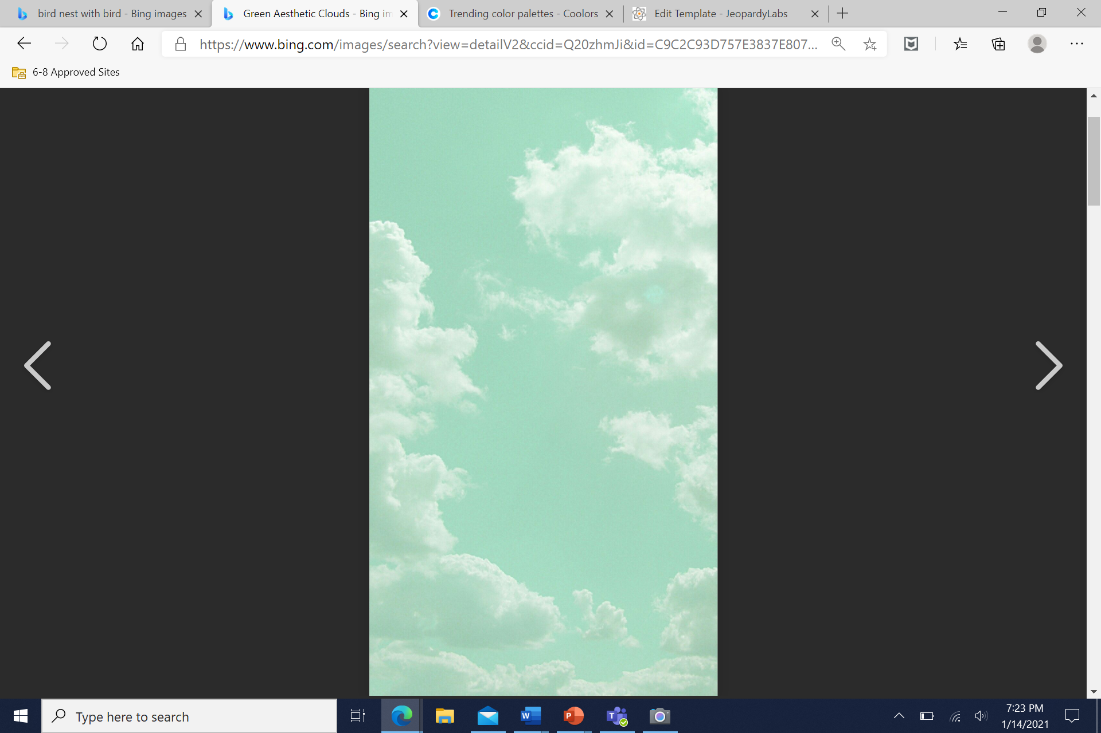
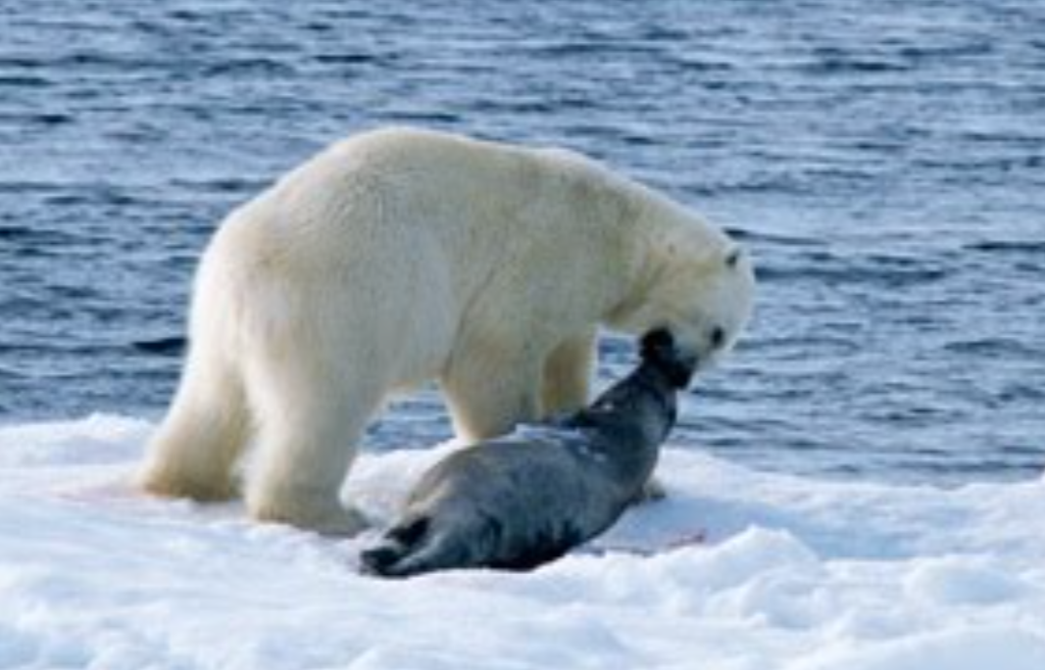

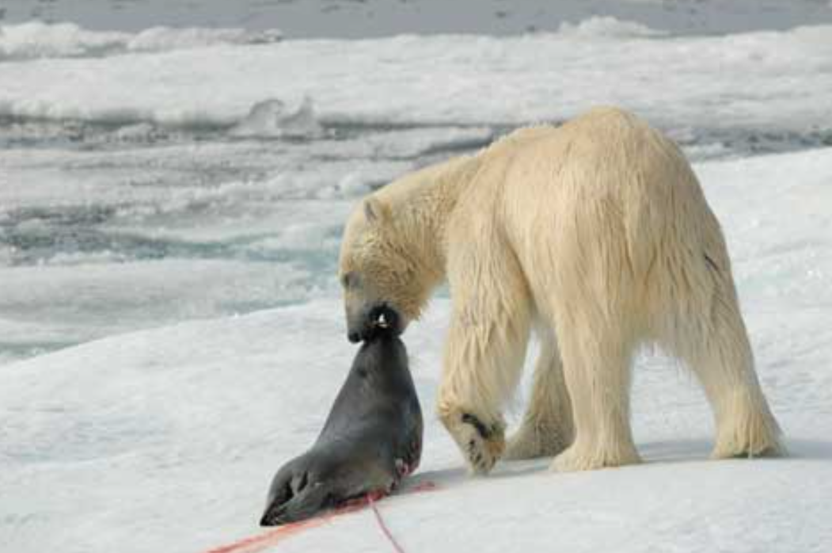
Predator
Prey
A predator is an organism that eats another organism, in this case, an animal that eats another animal.
Prey is the organism that gets eaten by the other organism. In this case, the animal that gets eaten by the predator.
An example of a predator would be a polar bear. A polar bear is at the top of a food chain, and it eats other animals. Therefore, it is a predator.
An example of a prey would be a seal. A seal is an animal that gets eaten by polar bears. Therefore, it is a prey.
Predator
Prey

Slide 18
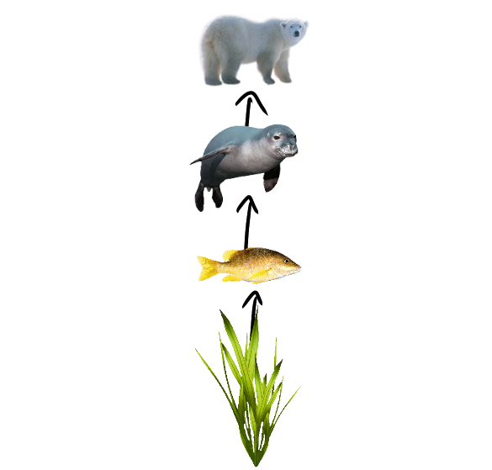
Predator and Prey Food Chain – Polar Bears and Seals
Polar bear – Tertiary consumer
Seal – Secondary consumer
Fish – Primary consumer
Algae – Producer

Slide 19
Cause
Effect
The predator (polar bear) is continuously eating the prey (seals).
The prey’s population decreases because and the predator’s population increases.
The predator’s population will decrease because there is not enough prey to feed on, causing the prey’s population to grow again.
The predator’s population grows, causing more and more prey to get killed.
The two populations are constantly increasing and decreasing.
The two populations are at balance and will stay balanced unless something disrupts the balance of the populations.

Slide 20

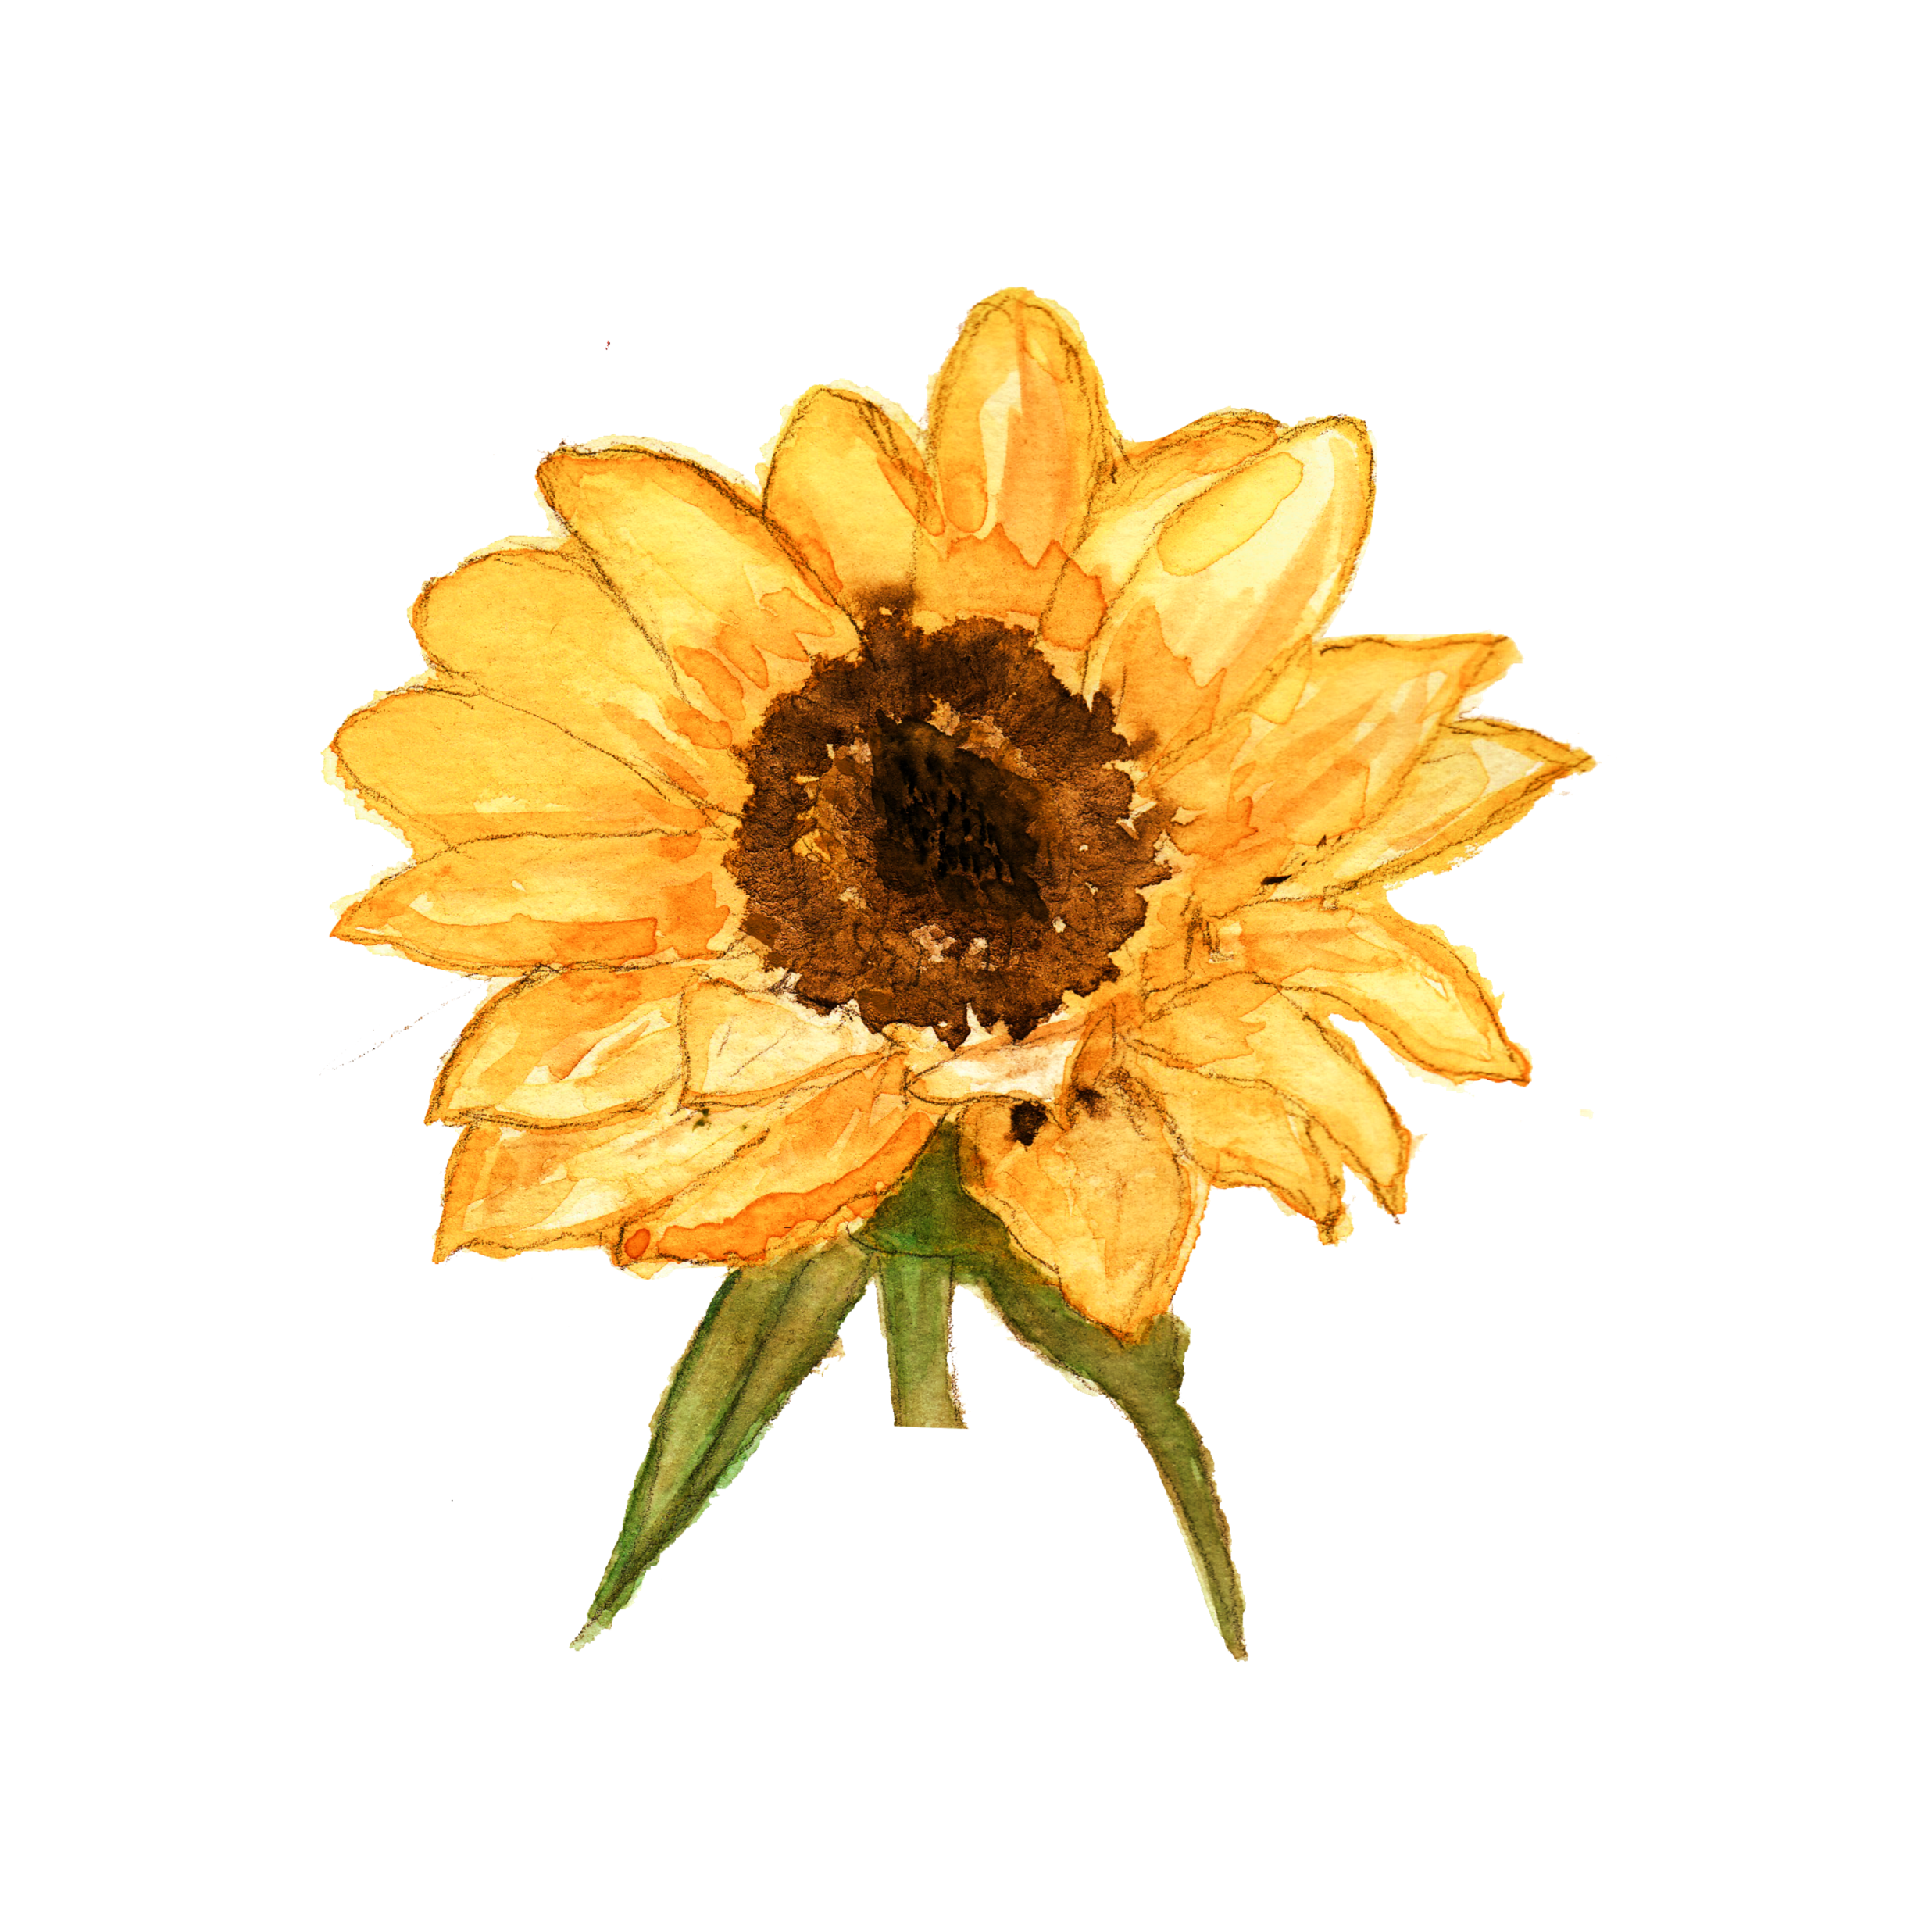
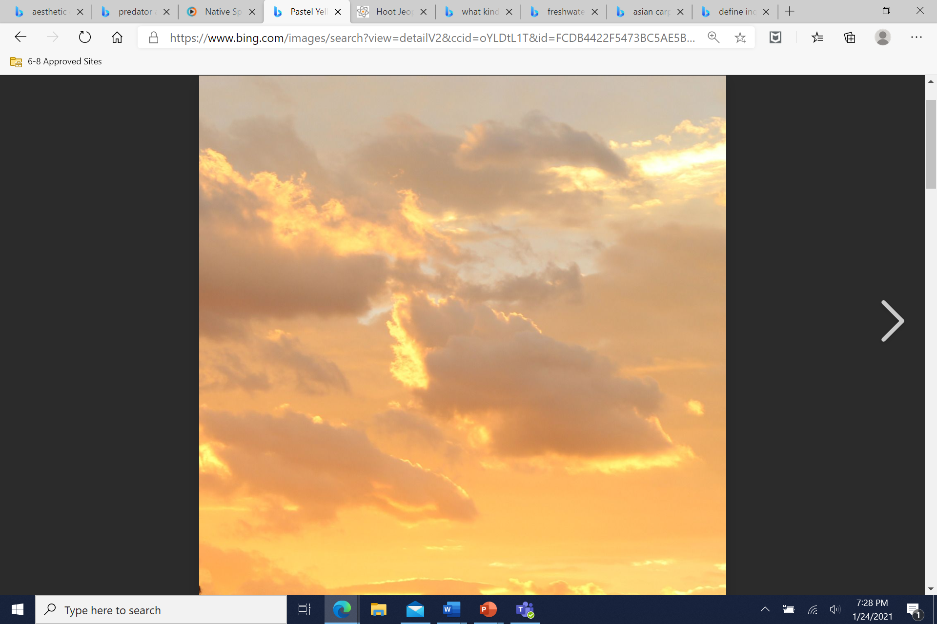
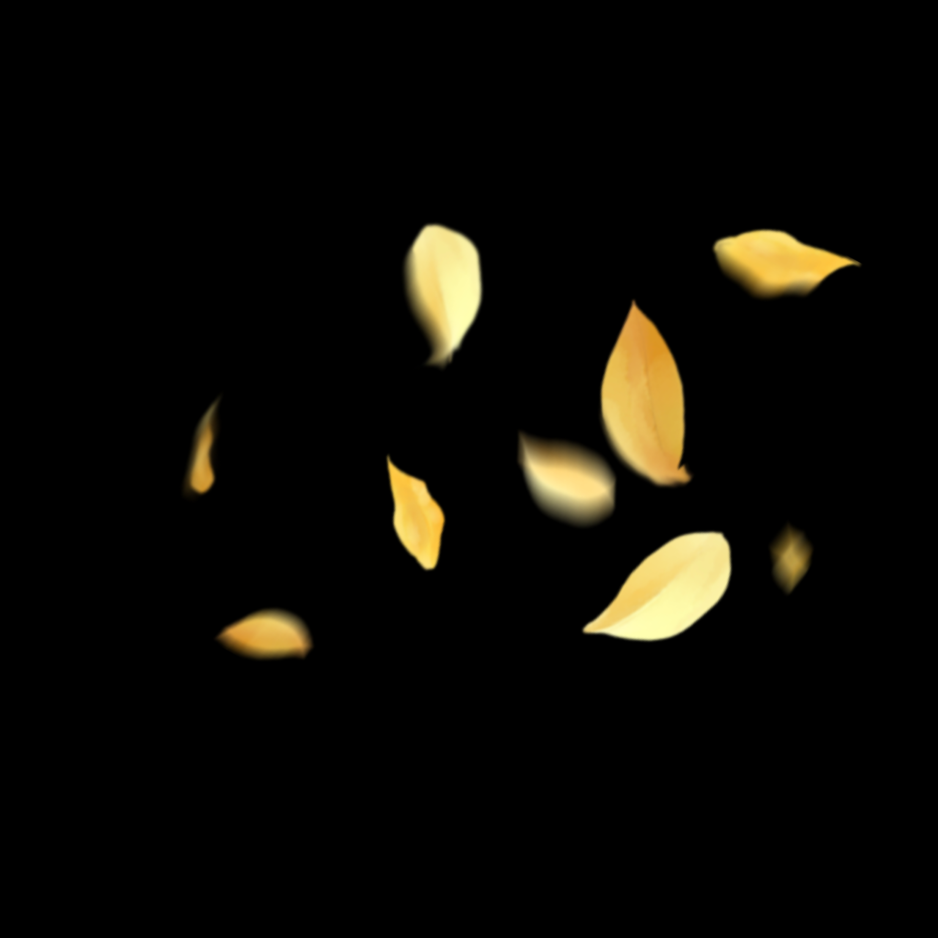
Thank you for your time, and I apologize if it may have been too long.
If you were confused about anything, you can email me your inquiries, and I can help you.
Helen Vo

